Slide 1
UAV (Unmanned Aerial Vehicle) Delivery System
Jianhui li
May 15th , 2018
UWO

Slide 2
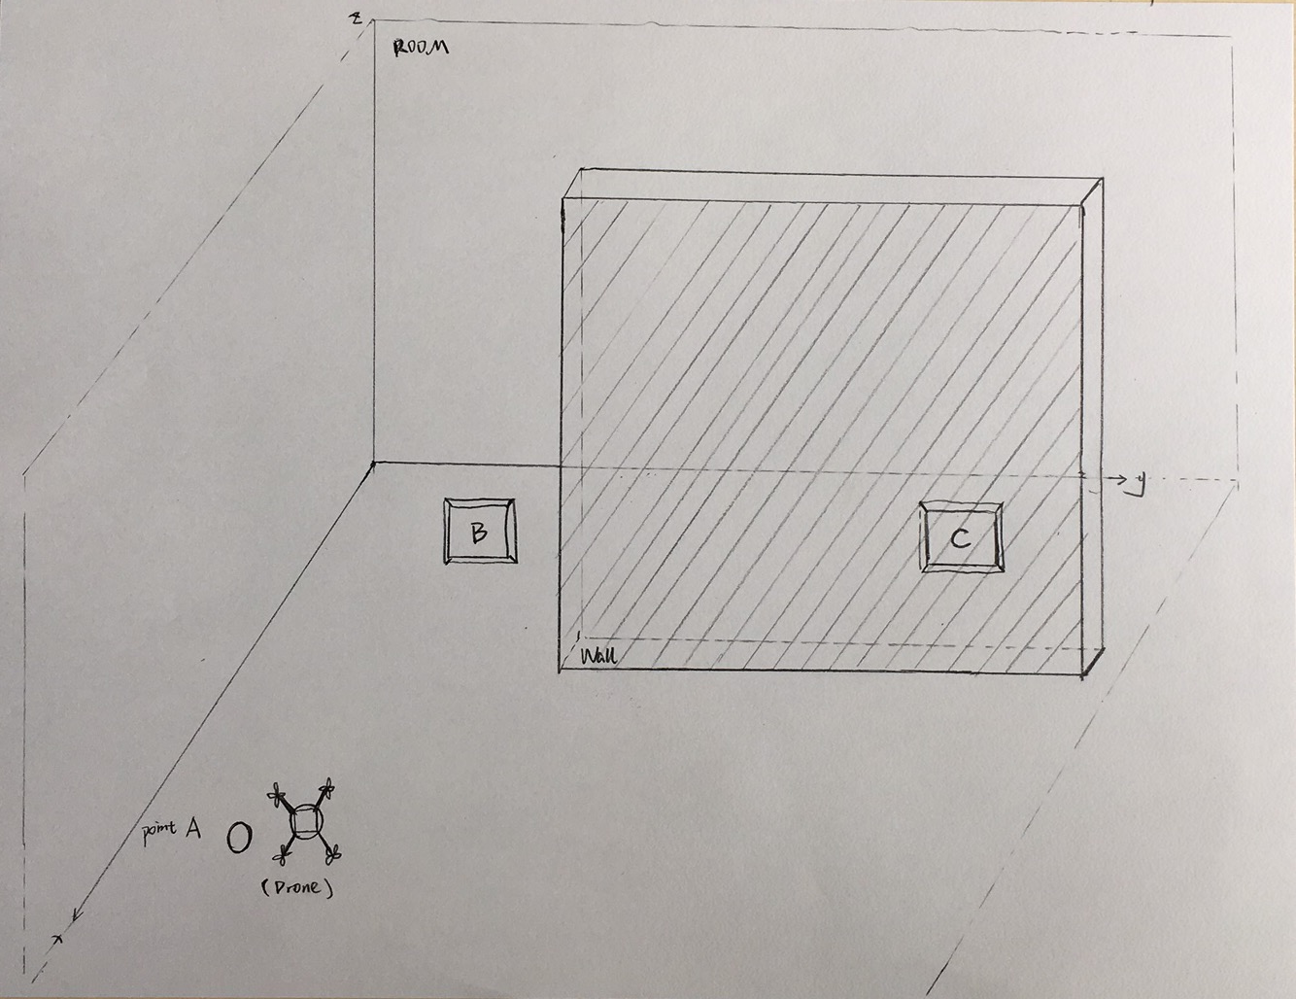
Concept
Basic problem definition:
The UAV delivery system will be tested in a closed space. The mission of the drone is to send a package from point A to point B and C separately. The drone can grab the package by a designed peripheral. There is wall between point A and point C. Therefore, the drone also need to detect the wall and then choose a new path to cross the wall to arrive point C.

Slide 3
Required equipment:
Drone development platform
DJI Matric 100 Vs Intel® Aero

Slide 4
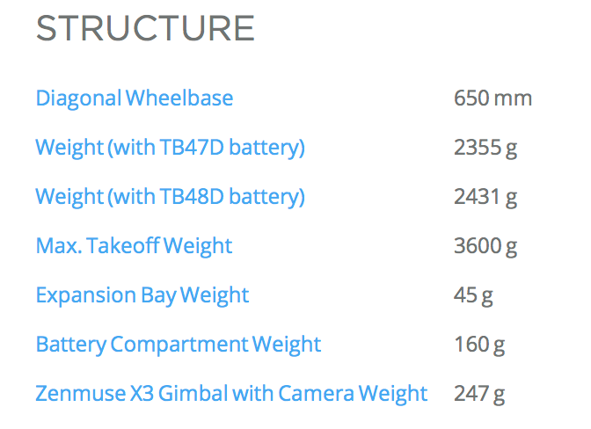
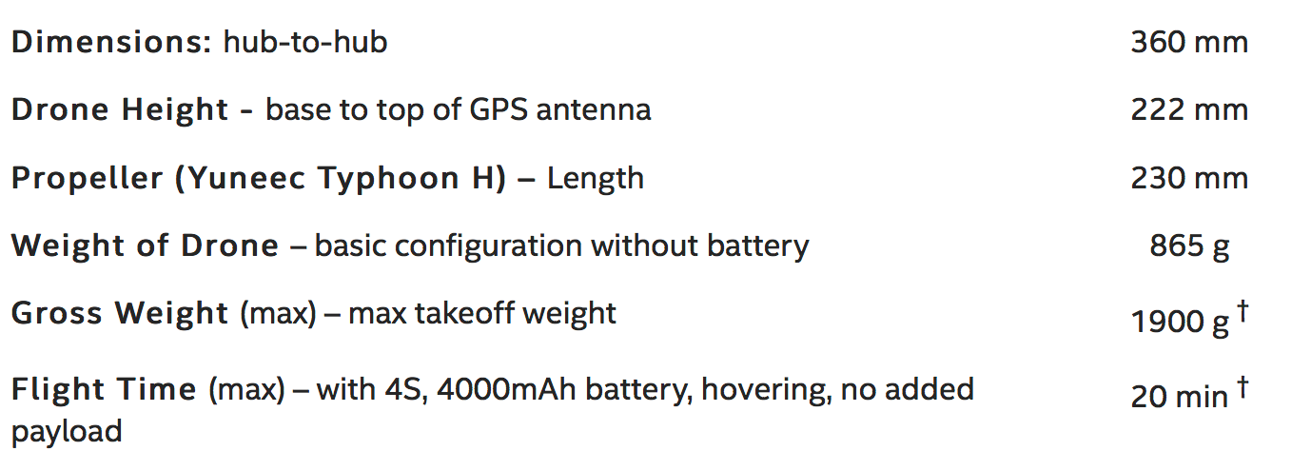
Spec comparison
DJI Matric 100 Vs Intel® Aero
DJI M100 has a better take off weight, which can add more sensors.

Slide 5
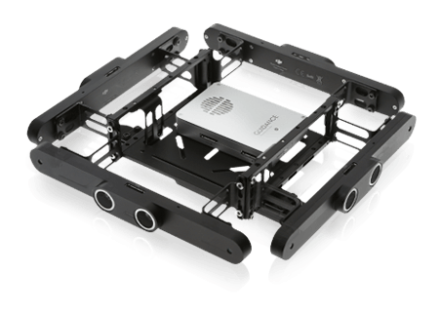
Required features: avoid collision
The UAV is tested in a closed room. It may face the collision frequently. Avoiding collision system can help protect the drone and user.
DJI Matric 100 Vs Intel® Aero
Guidance includes five sensor modules and one central processor. So it can detects five directions.
Canot find exact information from official website

Slide 6
Required features: need to find targets and detect surroundings by OpenCV
The UAV is designed to find targets by pattern recognition. For example, when the camera read a letter “A” in point A, the UAV can land on the top of letter. Besides, the camera can help the drone to look for a new path when facing a block.
DJI Matric 100 Vs Intel® Aero
Zenmuse X3 Gimbal And Camera is the standard and compatible equipment supported by the official.
It is fully functional, and can rotate full 360⁰ range.
Lightbridge system support this camera to upload video to mobile or PC.
8MP RGB camera (front-facing), and cannot rotate
3D RealSense

Slide 7
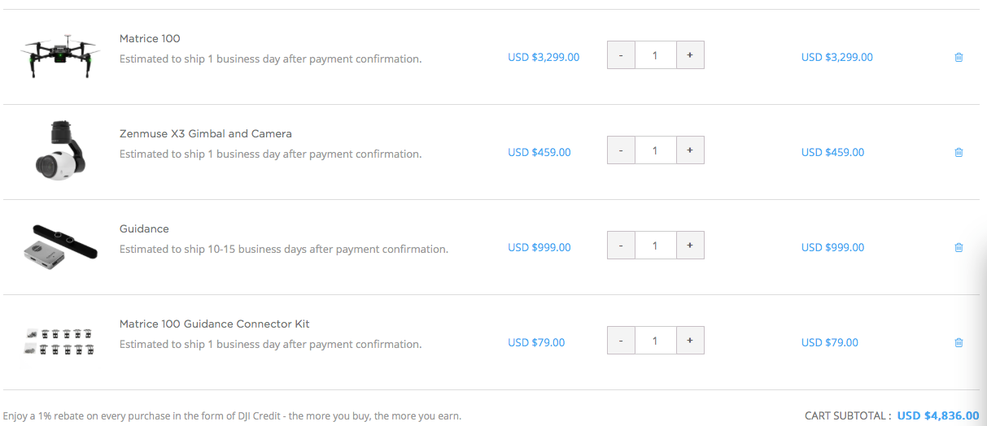
Pros and cons of DJI
Pros:
Simulation software, which can test the path of UAV without propeller.
Mobile SDK, which means designed APP can use to control the UAV
Onboard SDK, with manifold, which can process patterns
More recourses for developer than intel aero
Can add peripherals with the manifold.
Suitable for this project and can use to develop more for the future
Cons:
More expensive. At least $4836

Slide 8
Pros and cons of intel aero
Pros:
Cheaper price. Ex. $1099 without battery
Intel Aero Compute Board has Intel® Atom™ x7-Z8750 processor
4 GB LPDDR3-1600, which is a strong processing ability.
Friendly to software developer to build application for UAVS
Cons:
Less recourses due to new product. May hard to get help
Compared to DJI, it doesn‘t have simulation software and many develop kits

Slide 9
DJI function: Mobile SDK
The Mobile SDK allows developers to monitor and control the UAV from a mobile device running iOS or Android when connected to a remote controller.
Sometimes it is useful combine the flexibility of the Mobile SDK with the real time versatility of the Onboard SDK. Both the Onboard and Mobile SDKs have APIs that allow custom data to be sent between the onboard computer and the mobile device.

Slide 10
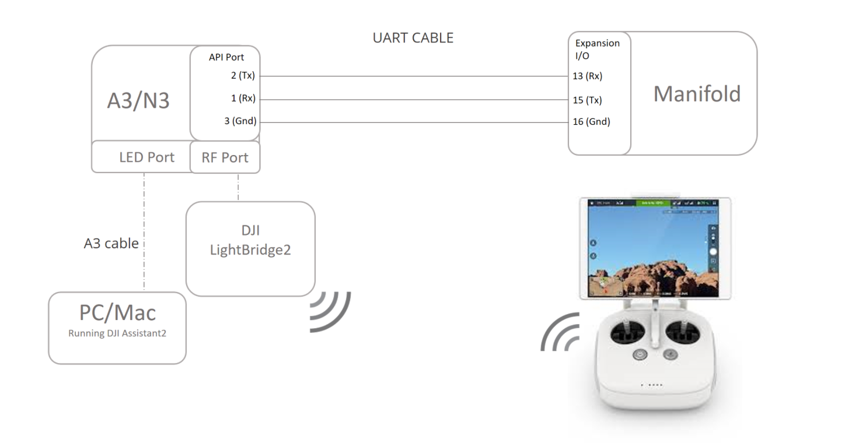
DJI function: onboard SDK
The DJI Onboard SDK is an open source software library that enables computers to communicate directly with a selection of DJI aircraft and flight controllers over a serial interface. The SDK gives access to aircraft telemetry, flight control and other aircraft functions, meaning a developer can use the SDK to attach their own computing device onboard an aircraft and use it to control flight.

Slide 11
an open source C++ library that can be used to control DJI aircraft over a serial interface - with support for Linux, ARM and STM32
fully featured ROS wrapper compatible with ROS standards
an aircraft simulator and visualization tool
sample code and tutorials
this developer guide and API documentation

Slide 12
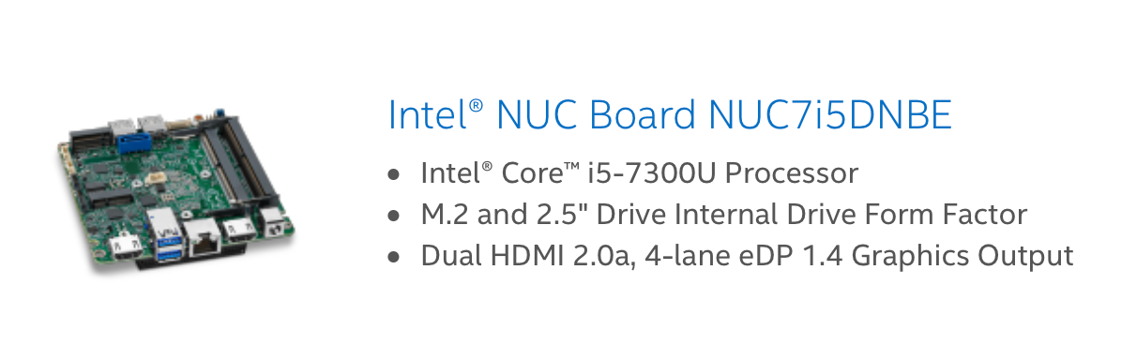
Additional necessary accessory
Intel NUC:
The whole project will use a mini-PC to run ROS to realize complicated tasks. DJI onboard SDK can use it as the main platform to control the UAV. Besides, the USB port can be used to connect Arduino, raspberry pi or STM 32, which can control a claw easily. The Intel NUC is also capable to deal with pattern processing, and support more advanced method to update the UAV. Ex, using ROS

Slide 13
DJI manifold (optional)
DJI manifold is an recommended accessories, it can take the video from the DJI’s camera directly. The other platform doesn’t have authority to access the official supported camera.

